Slide 1
NMT: Translation to English from Germanic and Romance Languages
Rachael Dewey & Maggie Sellers

Slide 2
Background

Slide 3
Research Question
The goal of our project is to use Neural Machine Translation (NMT) to explore whether translations to English from other Germanic languages are more accurate than translations to English from Romance languages.

Slide 4
Hypothesis
For the purposes of this exploration, we have selected three languages to work with in addition to English: German, French, and Italian.
We hypothesize that translations to English from other Germanic languages will be more accurate than translations from Romance languages; therefore, we believe that translations from German to English will be the most accurate, as they are both Germanic languages that share the same root language of Proto-Germanic.
Of the two Romance languages, we believe that translations from French will be the most accurate. This is because the Norman William the Conqueror conquered England in the 11th century and as a result, the English language has a great deal of French influence.
Finally, English and Italian share the most distant linguistic relationship, which we believe will result in the least accurate translations.

Slide 5
Prior Work
Multilingual Neural Machine Translation with Language Clustering by Tan et al.
explores the use of multilingual NMTs using languages clustered according to language family
A Gentle Introduction to Neural Machine Translation by Brownlee
provides important information on NMT and the basics of the various NMT models
Mutual Intelligibility between Closely Related Languages in Europe by Gooskens et al.
discusses the historical background of the mutual intelligibility among romance and germanic language families
Interactive Neural Machine Translation by Peris et al.
discusses the role of human input over the course of a neural machine translation algorithm’s execution to improve the accuracy of the translation

Slide 6
Approach
Dataset derived from the Tatoeba Project
Construct several models
Baseline Model: LSTM Encoder-Decoder RNN
Final Model: GRU Encoder-Decoder RNN
Train and test models on datasets for three source languages
Target Language: English
Source Languages: French, Italian, German
Evaluate the performance of models on average BLEU score and ROUGE scores

Slide 7
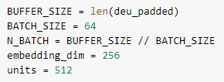
Approach
Tokenization and padding
Input pipeline
Define encoder-decoder architecture
Defining optimizer and loss function
Training loop
Evaluating test data

Slide 8
Results

Slide 9
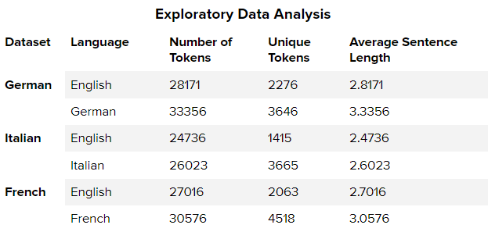
Results: Exploratory Data Analysis

Slide 10
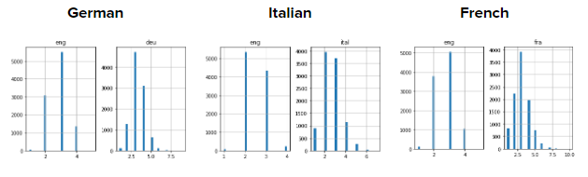
Results: Exploratory Data Analysis

Slide 11
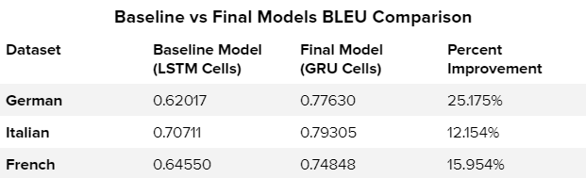
Results: Baseline vs Final Models

Slide 12
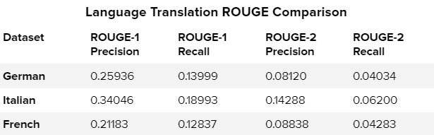
Results: Language Translation Comparison Based on Final Model

Slide 13
Results: Insights from the Models
Using the BLEU and ROUGE metrics, we found that the Italian model performed the best, followed by German, and then finally French
This did not support our hypothesis that languages that are more closely related linguistically will tend to perform better in Neural Machine Translation.
One reason for the high performance of the Italian model might be due to the fact that the Italian source language data has a lower average sentence length and smaller maximum sentence length than the other source language data.
Further exploration into the relationship between historical linguistics and Neural Machine Translation could calculate similarity measures between languages and use larger datasets and more languages to improve results. Future work could also continue to explore the performance of multilingual Neural Machine Translation on different language clusters.

Slide 14
Team Member Contributions
Team Member | Contributions
Rachael Dewey | Half of Project Proposal Preprocessing and Exploratory Data Analysis for French dataset Baseline Model implementation for French dataset Selected and implemented primary evaluation metrics for all datasets Final Model implementation for Italian and French datasets Final Report sections B and E-G; worked on C-D Presentation slide deck
Maggie Sellers | Proposed selected project topic Half of Project Proposal Discovered code references Preprocessing and Exploratory Data Analysis for German and Italian datasets Baseline Model implementation for the German and Italian datasets Final Model implementation for German dataset Worked on Final Report sections C-D

